Slide 1
Dry Eye Webinar
February 21, 2026
Jill Kostrinsky

Slide 2
Causes
Incomplete eyelid closure (botox, myectomy, cataract surgery)
Our natural tear flow is disrupted
Meibomian gland disfunction
Lasik surgery, aging, Sjogren’s
Focus today will be on practical strategies and products to decrease discomfort from dry eye
Symptoms
Burning, light sensitivity, heavy sticky lids, itchiness, stinging, soreness, blurriness

Slide 3
Dry eye lifestyle challenges
Hard to get through the day
Driving
Can’t wear makeup (mascara!)
Working on a computer, reading
Social stressers (no one understands)
Restaurant seat selection

Slide 4
Strategies & Products - first line of treatment
OTC drops – gels, drops, ointments
Refresh, Ivizia, Systane (use ONLY preservative free)
Systane, Ivizia comes in preservative free bottles – good for 90 days
Overnight ointments – Systane, Optase Hylo, Soothe, Refresh PM
Avoid BAC preservatives (Benzalkonium Chloride)
Lanolin alcohol in some drops can be irritating to some people
Muro 128 5% ointment for corneal edema (swelling)

Slide 5
Strategies & Products (continued)
OTC cleaners and wipes:
Hypochlor spray and blephadex wipes (softer than OcuSoft brand wipes)
Ocusoft foaming eyelid cleaners.
TearRestore Nutrawipe Eco wipes
Optase dry eye spray (use on closed eyes)
Don’t use baby shampoo - it can damage tear film

Slide 6
RX drops:
Upneeq - occasional use only for opening your eyes on special occasions. BUT can cause dry eye to get worse!
Cyclosporine drops such as Restasis, Cequa, Vevye, Ikervis (in Europe),
Xiidra (zye-dra) (active ingredient is lifitegrast),
Tyrvaya nasal spray (varenicline)
Xiidra works faster (2-4 wks) than Restasis (3-6 months).
They both reduce inflammation and increase tear production.

Slide 7
Rx Drops (continued)
Miebo - single ingredient drug. Forms a protective layer on the eye to reduce evaporation and keep tears from evaporating
Xdemvy - antiparasitic eye drop contains Lotilaner which treats Demodex blepharitis (eyelid inflammation from mites)
TRYPTYR (trip-ter) eye drops (stimulates natural tear production)
Use artificial tears 5-15 minutes before Rx drops

Slide 8
Gadgets and Devices
Mepitac tape
silicon tape better tolerated than plastic or paper tapes
Plastic wrap – Glad Cling and Seal over the eye
Avenova – I-chek magnifying mirror ($30 on Amazon)

Slide 9
Moisture chamber glasses
Ziena eyewear (www.Zienaeyewear.com ),
Ziena glasses are suitable for work and look good. ($180-$200). These have a removeable silicone shield. Protects from HVAC vents and fans.
7Eye airshield glasses (https://7eye.com/collections/airshield ),
Wiley X (https://www.wileyx.com/collections/performance-series)
These glasses have a removeable foam gasket that keeps you protected all the way around- good for wind sensitivity.

Slide 10
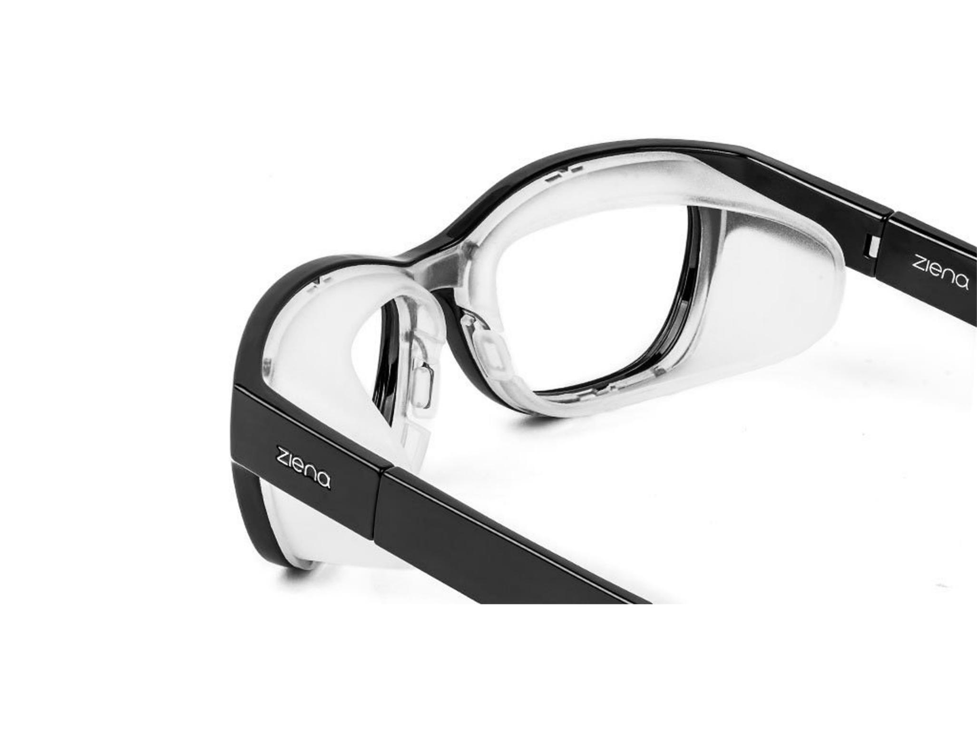

Slide 11
Gadgets and devices (continued)
7Eye will send you 3 frame styles to try using their “Try before You Buy” program. Cost $33 ($10 goes towards a purchase).
Other protective sunglasses & goggles
$5 safety goggles to wear over glasses (Home Depot),
Motorcycle goggles (i.e. Guard dogs Evader, Amazon $35 or https://guarddogs.com/collections/dry-eye-goggles ,

Slide 12
Gadgets and devices (continued)
Photosensitivity – FL-41 lenses
Zenni (www.zennioptical.com )
3 tint levels: 25% (light tint for indoor use), 50% ( medium tint for indoor and outdoor), 80% (dark tint for outdoor use)
Can get them nonprescription, single vision, progressive, bifocals and readers
7eye does not sell FL-41 lenses
Axon optics sells FL-41 Avulux lenses and frames www.axonoptics.com
Theraspecs sells FL-41 lenses and frames www.theraspecs.com

Slide 13
Gadgets and Devices (continued)
EyeEco (PRNVision.com) masks – tranquileyes ($50-$100), eyecloud kit ($160), Petite Mask Onyix/Quartz ($52), eye seals ($60),
Bruder warm compress ($21 Amazon) , Thermalon dry eye moist heat compress ($10 Amazon)
Sleep Masks – Manta ($39 Amazon), Dream Essentials ($20 Amazon), Blink Joy (Moist heat eye compress $40, Hydrating sleep mask $85, Rechargeable heat mask $150).
Low cost Amazon sleep masks ($10 for 3 masks). LKY Digital
Hugger mugger eye mask ($28 on Amazon)
Wizard dry eye heat mask - plugs into the car for traveling ($89 Amazon)

Slide 14
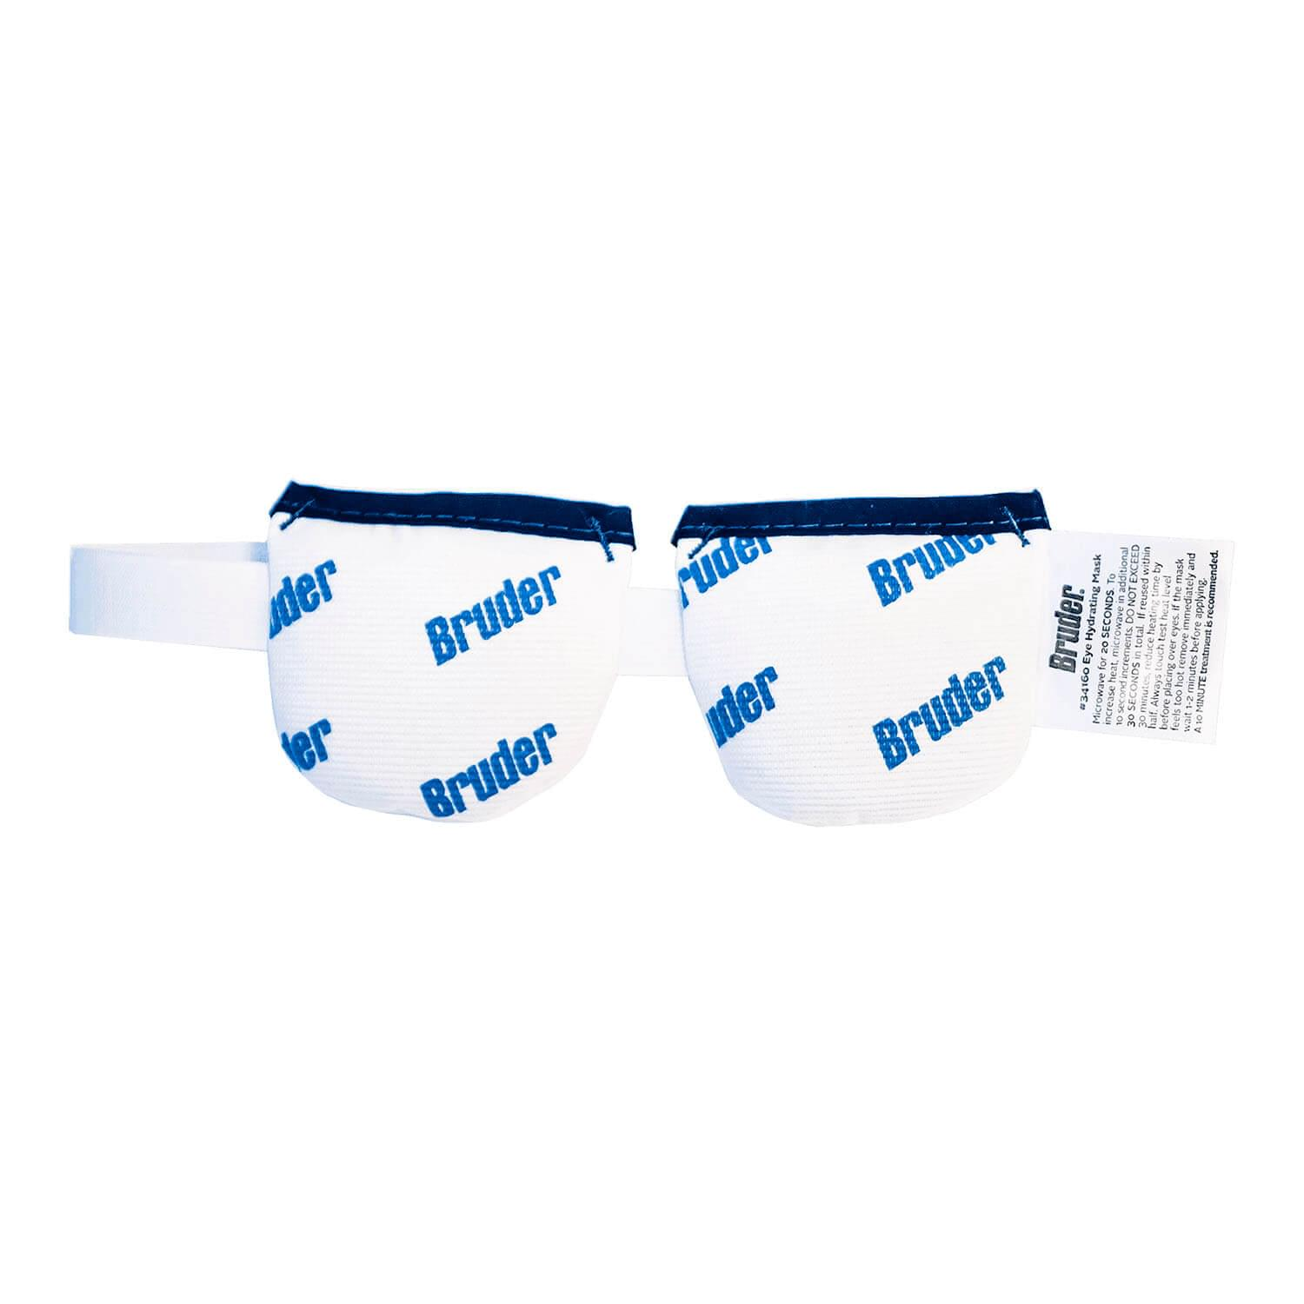

Slide 15
In office procedures
Serum tears – they take a vial of your blood and create a serum
VitalTears specializes in this (Vitaltears.org) , and so does Bascom Palmer Eye Institute in Miami https://umiamihealth.org/en/bascom-palmer-eye-institute
Platelet rich plasma (more concentrated than serum tears)
Amniotic membrane treatment – for severe dry eye and corneal damage, ocular surface disease
Scleral lenses
They vault completely over the cornea rest on the white part of the eye. Only the fluid touches the cornea. You can still feel them, but not like contacts.

Slide 16
In office procedures (continued)
IPL (intense pulse light)
Ilux - treatment for Meibomian gland disfunction
Tear Care treatment for Meibomian gland disfunction (heat applied to Meibomian glands and then expression of glands)
Lipiflow (heat and massage pressure)
Punctal plugs (blocks your tears to raise the water level)
Semi permanent silicon plugs, temporary dissolvable collegen

Slide 17
Warnings & Resources
Warnings
Only buy from manufacturers; NOT a 3rd party (if buying on Amazon). Be wary of store brands! So many recalls.
On Amazon: search for the product, click on the product from the list, under the name of the product it says “visit the store.”
Go to dryeyezone.com for approved drugs. Click on “eye drop safety database”

Slide 18
Resources
Having blepharospasm is hard, but now we have another poorly understood condition. DRY EYE. There’s help… there’s so much help!
Dry eye foundation website (dryeyefoundation.org), newsletter
One on one with Rebecca Petris info@dryeyefoundation.org
Dry eye support group (2nd and 4th Friday of the month at 8:00am PST)
Dry eye zone – articles, blog, drug info
Dry eye talk forum dryeyefoundation.org/community

Slide 19
Resources (continued)
Dry eye foundation also has other support groups for Scleral lenses, mental health. Millennials and Gen Z
Dry eye support group calendar https://dryeyefoundation.app.neoncrm.com/np/clients/dryeyefoundation/publicaccess/eventCalendarBig.jsp
Dry eye appointment prep worksheet https://www.dryeyezone.com/appointment-worksheet
Rebecca Petris webinar on bleph website (BEBRF.org, events, webinars)
Dry eye self care tips www.dryeyefoundation.org/support

Slide 20
Resources (continued)
OSDI symptom scorer (show your doctor)
See your doctor first thing in the morning for cornea issues because it repairs as the day goes on
Schirmer test (measure tear production)
Cornea specialists are your best bet for a dry eye condition, but they are hard to get in to see right away. The doctor should look at tear production, Meibomian glands, lid structure and functions, and inflammation.

Slide 21
Things to do at home
Lower computer screens, gaze downward. Shorter screen time (more and more younger people have dry eye these days!)
Stay hydrated
Redirect or close HVAC vents
Increase humidity in the house. Use a hygrometer to measure it ($10-$15 on Amazon)

Slide 22
Things to do at home (continued)
Air purifier
Omega 3 oils, anti-inflammatory diet
Lid massage, warm compress, cold compress
Budget your eye time (rest a couple of times per day)
Audiobooks
Shorter driving times

Slide 23
Nothing works for everyone, but everything works for someone.

